Slide 1

Protection of public interest and the accountancy profession
Istanbul, Turkey
5 October 2018
Notes:
SLIDE 1
Good afternoon everyone.
My name is Alan Hatfield and I’m the executive director – strategy and development at ACCA.
It’s an honour to be here with you today for this Congress.
The agenda’s focus on change is excellent; it concentrates our minds on the role of the profession in protecting the public interest and where we are headed in terms of the future skills in the accountancy profession.
<CLICK>

Slide 2
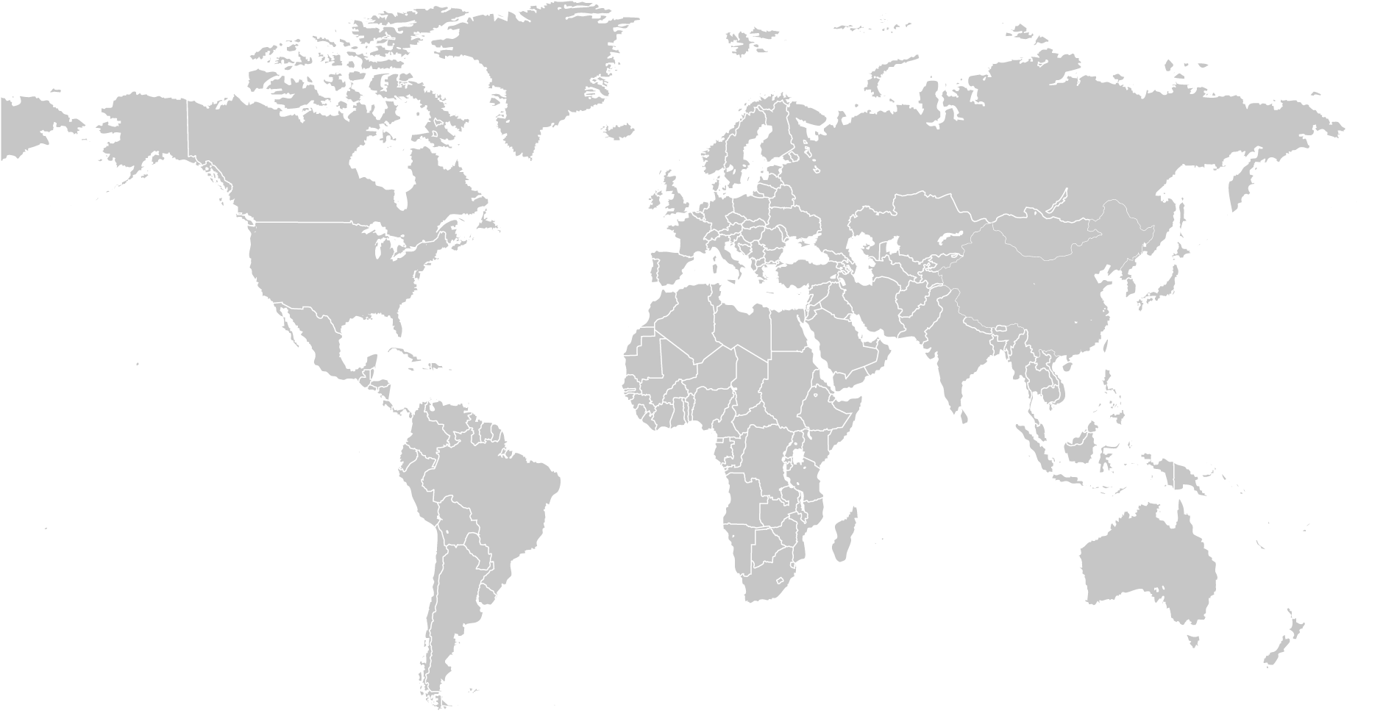
Developing the accountancy profession the world needs
208,000+ members
503,000+ students
180+ countries
100+ offices
80+ global partnerships
Notes:
SLIDE 2
Before I start, here is an overview of ACCA.
We were founded in the UK in 1904 and have grown into a truly global professional body. We have over 208K members and over half a million students in over 180 countries around the world. And we work as a partner with stakeholders around the world – with over 80 global partnerships with accountancy bodies, universities and international donor communities. Including working here in Turkey with our strategic partner TURMOB.
Our vision is to develop the accountancy profession the world needs.
Through our global network of members, future members and partners, ACCA protects the public interest and delivers value to the public by:
acting in the public interest
promoting ethical business
supporting economic growth
All of these are of course inter-connected and I’ll touch upon then directly or indirectly as I cover in the following slides, our view on the role of the profession in protecting the public interest.
<CLICK>

Slide 3
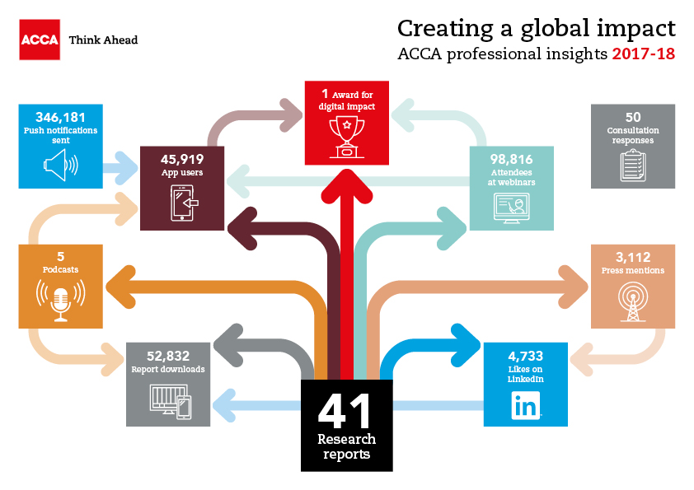
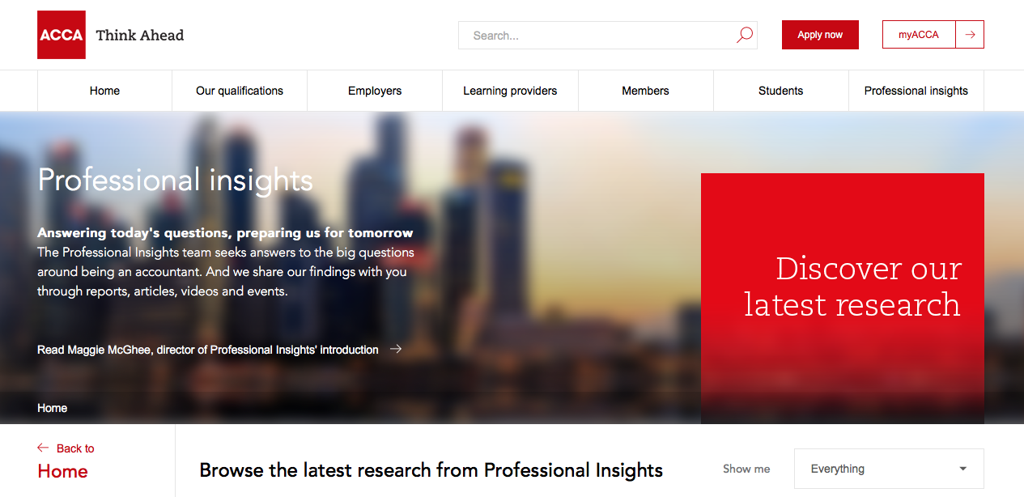
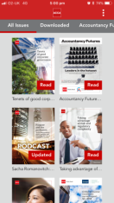
ACCA’s Professional Insights
accaglobal.com/insights
Insights on the go – 52k+ users in 202 countries
Notes:
SLIDE 3
ACCA’s thinking is freely available as a resource developed in the public interest. We have a wide range of reports – from audit to robotics, and a look ahead to the future of the profession.
<CLICK>

Slide 4

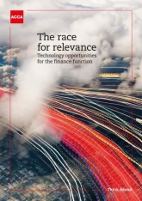

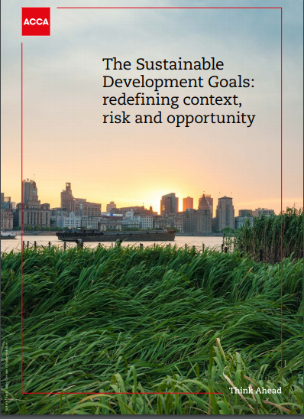

How can the profession contribute to protecting the public interest?
Public interest area
Examples of ACCA thinking
Ethics and trust
Ethics and trust in a digital age
Viable long-term performance
Race for relevance
Key Audit Matters
Sustainable development
The sustainable development goals
Fairness in society
Purpose and the profession
Notes:
SLIDE 4
So how can the profession play a role in protecting the public interest? To give a flavour of some of the areas, I’d like to touch upon 4 areas where we believe the accountancy profession plays an important role in protecting the public interest.
The first is the placing of ethics and trust at the heart of everything that the accountancy profession delivers
The second is thinking about the public interest when leveraging upside value potential, as well as when evaluating downside risks. This demands a profession that’s not driven by just a localised or short-term way of thinking about securing profits or avoiding losses.
The third is the profession recognising that the natural / environmental resources of the world are not infinite. And that a common/shared, ie public interest must guide the way these resources are optimised for all human-kind.
And the fourth is the role of the profession in making the world a fairer place. One with less inequality and more opportunity no matter where you come from. For the profession to really have a purpose beyond delivering good quality ‘outputs’.
These are all big issues and big questions. So what I want to do today is give you a taste of ACCA’s views, some of our activities and thinking relevant to each of these areas.
We’d of course be delighted to discuss further and keep the conversation going beyond today’s comments as well.
<CLICK>

Slide 5
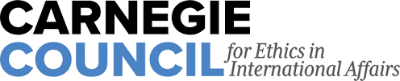



Ethics and trust: leading the agenda globally
International
Ethics Standards
Board for Accountants™
Notes:
SLIDE 5
So the first area is about Ethics and Trust.
This is a subject close to our hearts. In fact we’re marking Global Ethics Day (17 October 2018) by working with the Carnegie Council for Ethics in International Affairs and the CFA Institute. To mark this landmark occasion, our organisations will be exploring how businesses are preparing for an ethical future in the face of threats and challenges presented by globalisation, technology and human psychology.
Beginning with a series of ‘follow the sun’ events on Global Ethics Day itself, our three organisations are also producing a film interview series called ‘Ethics in business: in their own words’ which will feature a number of global CEOs, including: Helen Brand OBE, chief executive of ACCA, Paul Smith, president and CEO of CFA Institute and David MacLennan, chairman and CEO of Cargill discussing the greatest ethical challenge facing their respective organisations. ACCA Singapore and ACCA Hong Kong will also be running film festivals throughout October, showcasing documentaries Banking on Bitcoin (2016), a film about the cyber and digital monetary revolution; Big Men (2014), focusing on oil discovery in Africa and balancing risk and reward; and The Price We Pay (2014), where the impact of tax avoidance and offshoring by big business is analysed.
We’ve also conducted our own research and thought leadership in the field of ethics – on the screen here you can see our report focusing specifically on Digital Ethics, called Ethics and trust in a digital age. So emerging ethical issues that are becoming important for the profession to understand in a digital age. We were fortunate in this piece of work to have the support of IFAC and the report was peer reviewed by the technical director of the International Ethics Standards Board for Accountants (IESBA) as well as presented at their board meeting earlier this year. So it’s a piece of thinking that’s benefitted from the support of many partners to help make it as strong and credible as possible.
So lets reflect briefly on a few headline messages from the work.
<CLICK>

Slide 6
Do accountants believe they act in the public interest?
80%
Note: employed respondents
Notes:
SLIDE 6
The good news is that the vast majority of accountancy professionals believe that they act in the public interest. With 80% of respondents agreeing this was the case ‘almost’ or ‘always’.
I guess that’s a relief!
And it’s worth noting that this is a large sample of over 10k survey respondents globally.
<CLICK>

Slide 7
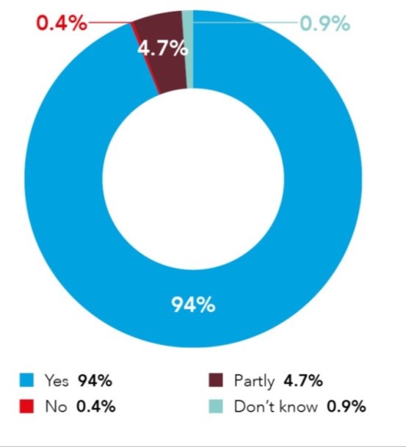
Fundamental ethical principles remain relevant in the digital age
IESBA principles still apply
and remain relevant
Integrity
Objectivity
Confidentiality
Professional competence and due care
Professional behaviour
Notes:
SLIDE 7
As we look ahead in a digital age, the fundamental principles underpinning ethics for accountants are NOT being called into question by respondents.
As a reminder, the 5 IESBA principles are
Integrity – so being honest and straight forward in professional and business dealings
Objectivity – avoiding bias
Confidentiality – managing information securely in line with authorisations
Prof Comp and due care – having the knowledge and skills for the job
Prof behaviour – following applicable rules and not bringing profession into disrepute
So what this says is that being ethical is about knowing how to INTERPRET these to new digital situations, whether with cyber security or with AI or Machine learning for example. Being ethical and protecting the public interest is not necessarily about looking for new check-lists of things to satisfy. In many ways that would have been easier. But in fact its about being able to think and challenge oneself to consider where ethical principles could be compromised in situations one may not have seen before.
<CLICK>

Slide 8
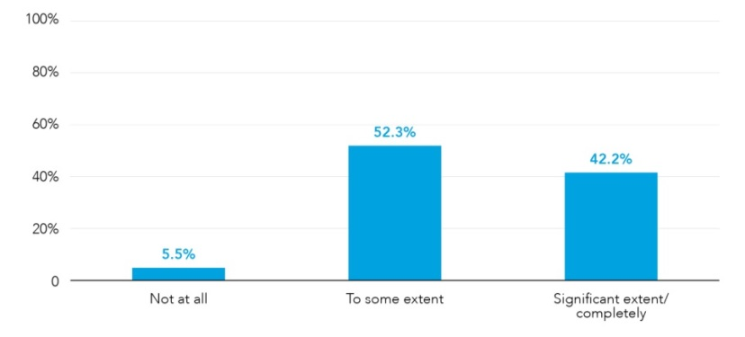
Ethics helps to build trust with the wider public
C-suite executives think that the accountant’s ethical behaviour helps the organisation build trust with internal and external stakeholders
94.5%
Notes:
SLIDE 8
As part of this work, we didn’t want just accountants talking about themselves. To get an ‘outside-in’ view we asked C-suite leaders to comment on the accountants in their organisation.
And one observation really stood out for us. The vast majority, almost 95 % of C-suite leaders felt that the accountant’s ethical behaviour helps the organisation build trust with internal and external stakeholders. And who are these ‘internal and external stakeholders’ that organisations can build trust with? Ultimately this is the public who’s interests we are talking about protecting today.
The fact is that accountants being ethical is a core bedrock of protecting the public interest.
<CLICK>

Slide 9
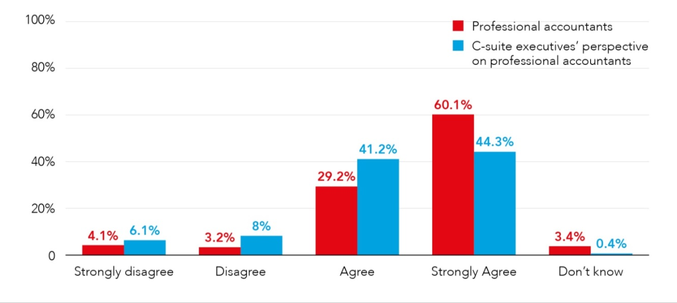
Impact of digital on ethics
Strong ethical principles and behaviour will become more important in the digital age
89%
86%
Notes:
SLIDE 9
And if anything, the importance of ethics is going to get even more critical in a digital future.
Some c-suite leaders for example anecdotally mentioned during the research that in a digital world with new systems, processes – sometimes whole new business models – it may be hard for accountants to stay aware of all the new developments.
So in this environment the basis for trust is even more dependent on being absolutely confident of the ethical behaviour, over and above technical capabilities.
<CLICK>

Slide 10
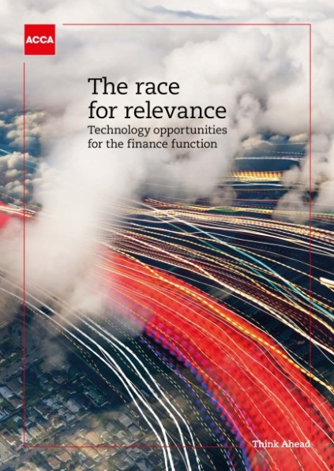

Viable long-term performance (1/3)
Notes:
SLIDE 10
I spent a bit more time on ethics because I believe it’s absolutely fundamental to any discussion about protecting the public interest. But of course, there is a wider conversation to be had, and I’d like now to reflect on some of the other aspects relevant to the public interest.
And the area I’d like to focus on now is the role of a profession that is not driven by just a localised or short-term way of thinking about securing profits or avoiding losses.
To consider a few reflections on value and risk, I’d like to draw on another ACCA report entitled the Race for relevance.
The report considered the impact of technology on how professional accountants operate now and in the future. It considered 6 key technology areas, namely, cyber security, Cloud, robotic process automation, data analytics, social media and artificial intelligence.
The details of these technologies are not relevant for today’s discussion. But what is relevant is that they affect the way in which professional accountants will need to create value for their organisations. And the nature of the risks that this presents.
At a systemic level across organisations in an economy, these changes in value and risk can affect the public in a wider sense. For example many of these technologies are based on a network principle that means you need to think more broadly than your own narrow interests. Taking cyber security as an example, you can’t just think about your own systems. If your suppliers or customers who have access to your portals get hacked you can be affected.
In a digital age the public interest can be threatened by one organisation being compromised. There are examples we can all think of where a global cyber hacking event started in one single location and then spread in a globally connected world.
So what is the role of professional accountants in protecting the public interest here?
<CLICK>

Slide 11


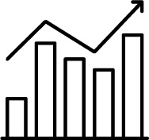
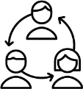


Viable long-term performance (2/3)
Align the strategy
Build the
business case
Appreciate the value of data
Manage the organisational impact of technology
change
Focus on talent and skills
Assess the impact of technology on governance / risk management
Notes:
SLIDE 11
The Race for relevance report articulated this as a way of thinking about how to build what is essentially Finance 4.0. A digital finance function that is thinking about things in the right way at the organisation level – which is the necessary stepping stone to protecting the public interest at the macro level.
So let’s unpack that picture a bit.
The first step is for finance to align with the overall strategy of the organisation. We have encountered countless examples of risks being introduced simply because for example, a finance transformation was completely misaligned with what the business was trying to achieve.
Second is building the business case. Digital involves different types of cost-benefit structures. Have we considered the impact of free or open-source solutions, including their risks? Do we understand the full benefits of a OPEX based monthly payment as-a-service or cloud model – as opposed to upfront CAPEX? Do we really know the end-to-end costs, for eg with upgrades – and not just what it says on the initial amount?
Third, do we really understand the data we hold as an organisation? In particular do we have a sense of the data quality, which can be a big risk both for us and other stakeholders we interact with internally and externally? In the research we found that data clean ups happened in big one-off exercises, with less focus on incremental on going data cleansing and management. Taken in aggregate across the system, bad data quality can seriously threaten the public interest.
The bottom 3 are important for getting the execution right. The organisation impact of technology change matters – particularly if people are losing their jobs! And governance, on the bottom right, is of course crucial to protecting the organisation and public from fraud and error. The middle one in the bottom speaks to skills needed by the professional accountant and I’ll talk more about that at the end, so I’ll skip that now and come to it in a few moments.
<CLICK>

Slide 12
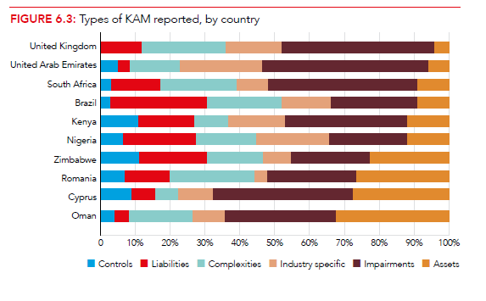
Viable long-term performance (3/3)
Notes:
SLIDE 12
The other perspective is of course the role of the auditor.
Recent changes to auditor reporting standards have not only improved the quality of information available to investors, but also had positive effects on broader elements of financial reporting, including governance and corporate reporting.
We have explored this in a report on Key Audit Matters entitled Key audit matters: unlocking the secrets of the audit
The report analyses the effects of changes to auditor reporting standards, which became applicable in many parts of the world from the December 2016 year-end audits. To do so, the report examines 560 audit reports across eleven countries and four continents.
The most obvious change has been the introduction of key audit matters which, in response to calls from stakeholders for more detail about the audit process and greater transparency and clarity of the audit report, requires the auditor to list the areas of the audit that involve the most risk and explain the audit approach to those areas.
In addition, the revised standards re-order the audit report to prioritise information that is most relevant to users, and improve the disclosure requirements around ‘going concern’ issues.
The report finds that these standards have resulted in the provision of better information for investors, and have also encouraged improvements throughout the financial reporting chain.
These are all steps in the right direction. Though we would caution that to truly protect the public interest it will be important to take a balanced approach. For regulators to reflect on the benefits of KAMs when enforcing auditing standards. But avoiding the risk of a 'tick box approach' to KAMs, thus losing the opportunity to communicate more effectively with audit committees and to stimulate better reporting.
<CLICK>

Slide 13
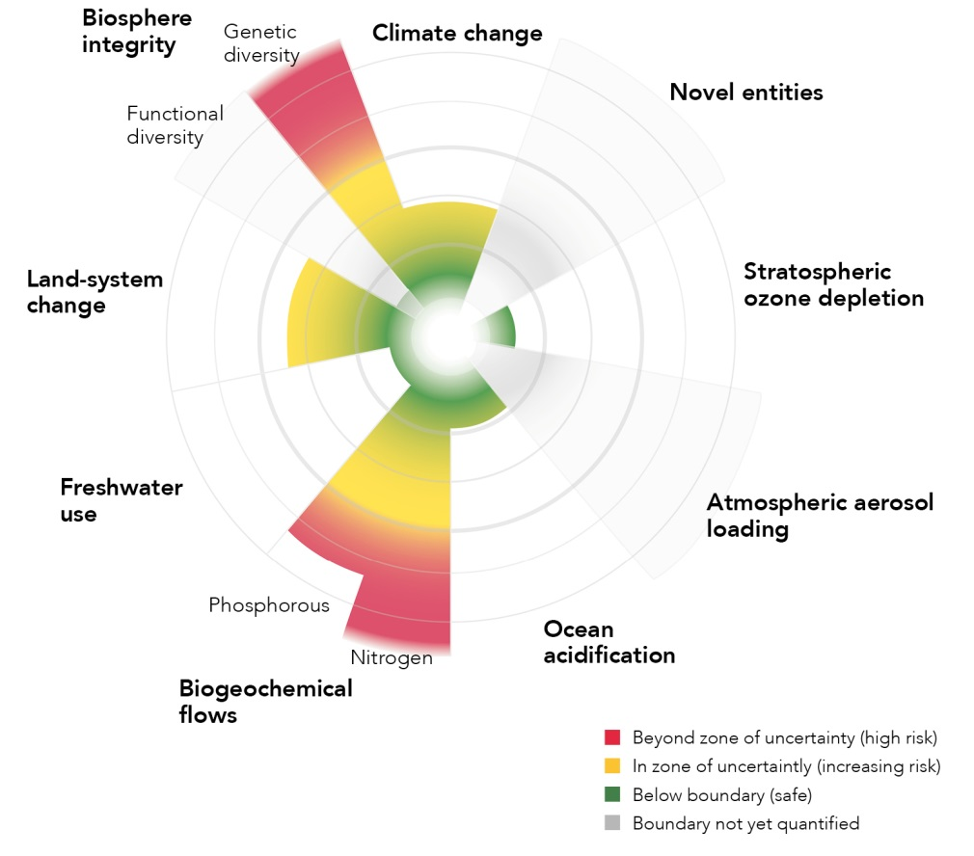
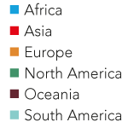
Environmental tipping points are at risk of breach
Source: Stockholm Resilience Centre
Notes:
SLIDE 13
One of the areas where the public interest exists almost by definition, is when thinking about the environment and the natural resources we all share on this planet.
It is meaningless to imagine that natural resource issues can be localised to one part of the world. Global warming affects us all. This is an areas of true common public interest.
And as you can see in this chart, natural resources are threatened across multiple dimensions.
And some of them are particularly high risk at present for example the depleting levels of phosphorus. It doesn’t sound exciting, and isn’t on the media headlines but this sort of thing affects us all. Phosphorus is needed by plants to grow. But with fertilisers humans are using it up in large quantities. And there is a finite amount of phosphorus on planet earth.
So there is a public interest issue here almost at an existential level for us as humans. But how to relate that to the agenda of the accountancy profession?
<CLICK>

Slide 14
Optimising resources and SDGs
Just over two years ago, world leaders gathered at the United Nations and agreed to deliver the 17 Sustainable Development Goals (SDGs)
This ambitious global framework for all countries to achieve by 2030 sets out the building blocks of a new type of inclusive prosperity creation that has as its motto ‘to leave no-one behind’
Across the 17 SDGs – and the 169 targets of which they are composed – are a range of interconnected economic, social and environmental issues
Notes:
SLIDE 14
There are many things to consider for the accountancy profession and the report sets out some of the key considerations. These include:
Chart the evolving ways that professional accountants will engage in the delivery of the SDGs.
Outline the factors behind the business case for the SDGs.
Explore how environmental, social and governance (ESG) issues are transforming finance.
Examine how corporate sustainability reporting frameworks are enabling business to engage with the SDGs.
Explore the implications of the recent recommendations of the Task Force on Climate-related Financial Disclosures (TCFD) and how they relate to professional accountants future role in addressing SDGs issues.
Provide recommendations for professional accountants and SDGs engagement.
<CLICK>

Slide 15
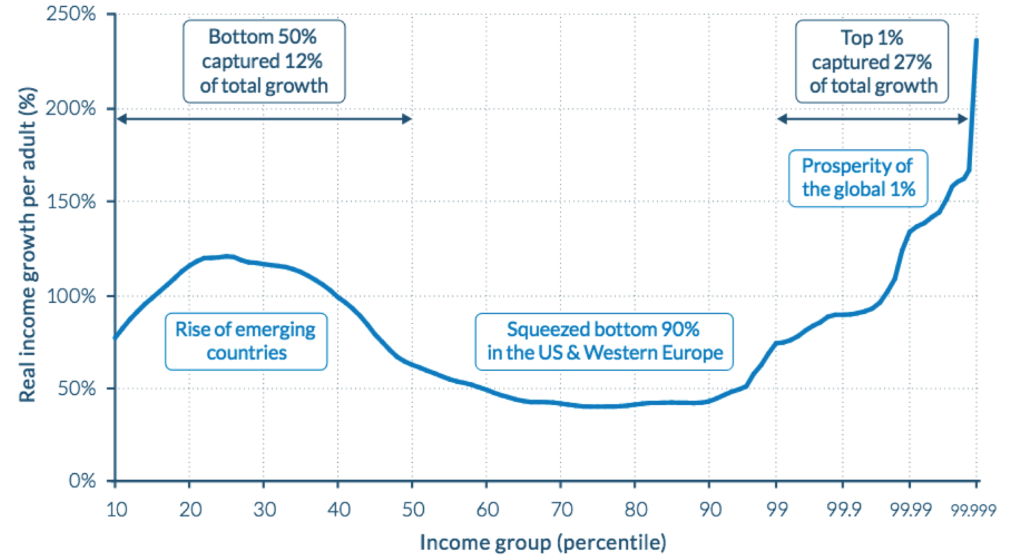
Income growth is uneven across regions
Income growth 1980-2016
Source: World Inequality Report 2018
Notes:
SLIDE 15
Inequality is one of the big challenges facing our world. And the most obvious way it is visible is via inequalities in income around the world.
If one looks at the chart, we can see real variations in income growth. The bottom x axis plots the income group. For eg 10-20…up to 50 is the bottom ½ of the world and 50 onwards are the income groups in the top ½ of the world.
The vertical y axis plots the real (ie adjusted for inflation) income growth per adult as a % growth figure over 1980-2016.
Like all charts, it’s a complex and varied picture, but lets look at it in pieces to try and understand a bit more.
<CLICK>
So on the left most are the poorest regions of the world up to the 50th decile. What we see is that the very poorest saw quite healthy income growth, but we must remember that they’re starting from the lowest base, so the only way is up one might argue. After that it flattens a bit as you look at slightly more wealthy groups and this corresponds roughly to formerly poorer nations like China moving more into the low-middle income group – and income growth flattening a bit as a result.
<CLICK>
Then we have the band from the 50th decile all the way to the 99th decile. And what we see here is depressed earning growth. This corresponds broadly with the poor/middle class population in more affluent, often western industrialised advanced economies. And it points to the stagnating wage growth seen here, linked to an extent to the decline in manufacturing and the many people who were less able to adjust to the shift to service economy.
<CLICK>
And on the extreme right we see the top 1% of the global population. These people are rich, and could be anywhere in the world. But what they have in common is that they have all enjoyed extremely high rates of income growth.
So the income inequality is a concern obviously, but more concerning can be intensified by the rich getting richer as this trend shows.
<CLICK>

Slide 16
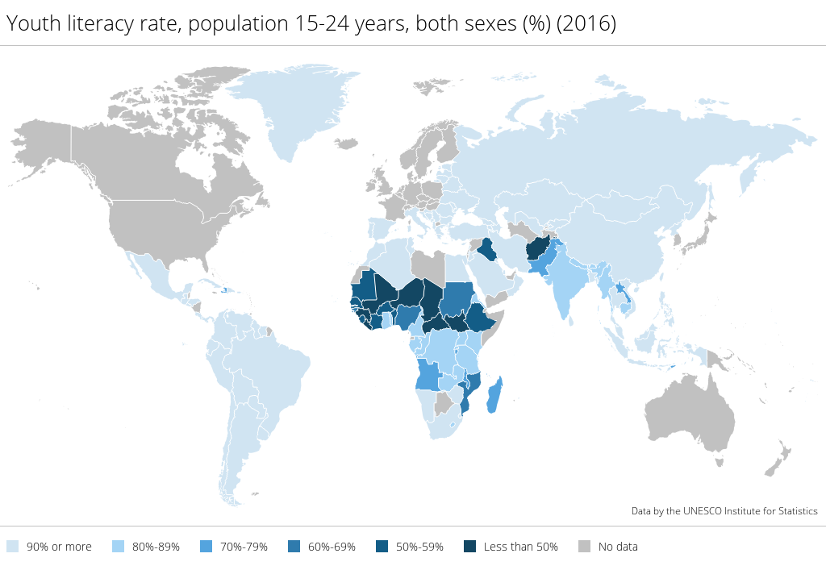
Social mobility and the accountancy profession
Proportion of literate youth, worldwide, 15-24 years, 2016
Notes:
SLIDE 16
So where does the accountancy profession fit into this as part of the solution? Our report Purpose and the profession explores this.
A professional accountancy qualification can provide individuals with the financial acumen to contribute meaningfully to the business world or the public sector. It can be a means of mobility in more senses than one, as it can act as a global passport – recognised equally in different countries, affording the qualification holder the opportunity to access opportunities that were not previously available to them in their original geographic location.
More must be done to promote retraining, infrastructure development and enabling of investment in left-behind regions. There is a strong role for the profession in making this happen and for professional bodies to use their resources, knowledge and networks to make training in financial management and accountancy available and accessible to people who are unable to move to urban areas.
Awareness: making the profession better known as a career choice There is a need to make the profession better known as a career choice among those who have not grown up among family and friends with professional qualifications or university degrees and those that live in areas that lack opportunities.
Removing barriers: making qualifications and employment opportunities more accessible Making qualifications more accessible means continuing to improve flexibility in learning and examinations to meet the education needs of current student cohorts. Flexible learning that is more digestible, more relevant and more targeted than traditional methods will continue to be demanded, alongside traditional practices. Increasingly flexible approaches allow individuals who may not previously have been able to access qualifications, owing to work or family commitments, to be able to study at their own pace and for a part of the qualification that is meaningful for them.
<CLICK>

Slide 17

Professional accountant of the future
Notes:
SLIDE 17
Amidst all these challenges, the profession needs to change.
Given economic developments, and the changes ahead, we believe finance professionals need to adapt.
There are now broader roles for and changing expectations of the profession.
As the business sector evolves, the expectations that businesses have of professional accountants change too.
All professional accountants will be expected to look beyond the numbers, and to possess a variety of skills.
For example, the demand for more sustainable business means that finance professionals will need to meet more frequent requests for holistic and forward-looking information, and may also face demands for more frequent ad-hoc reporting from stakeholders as the barriers are eroded between financial and non-financial performance.
<CLICK>

Slide 18
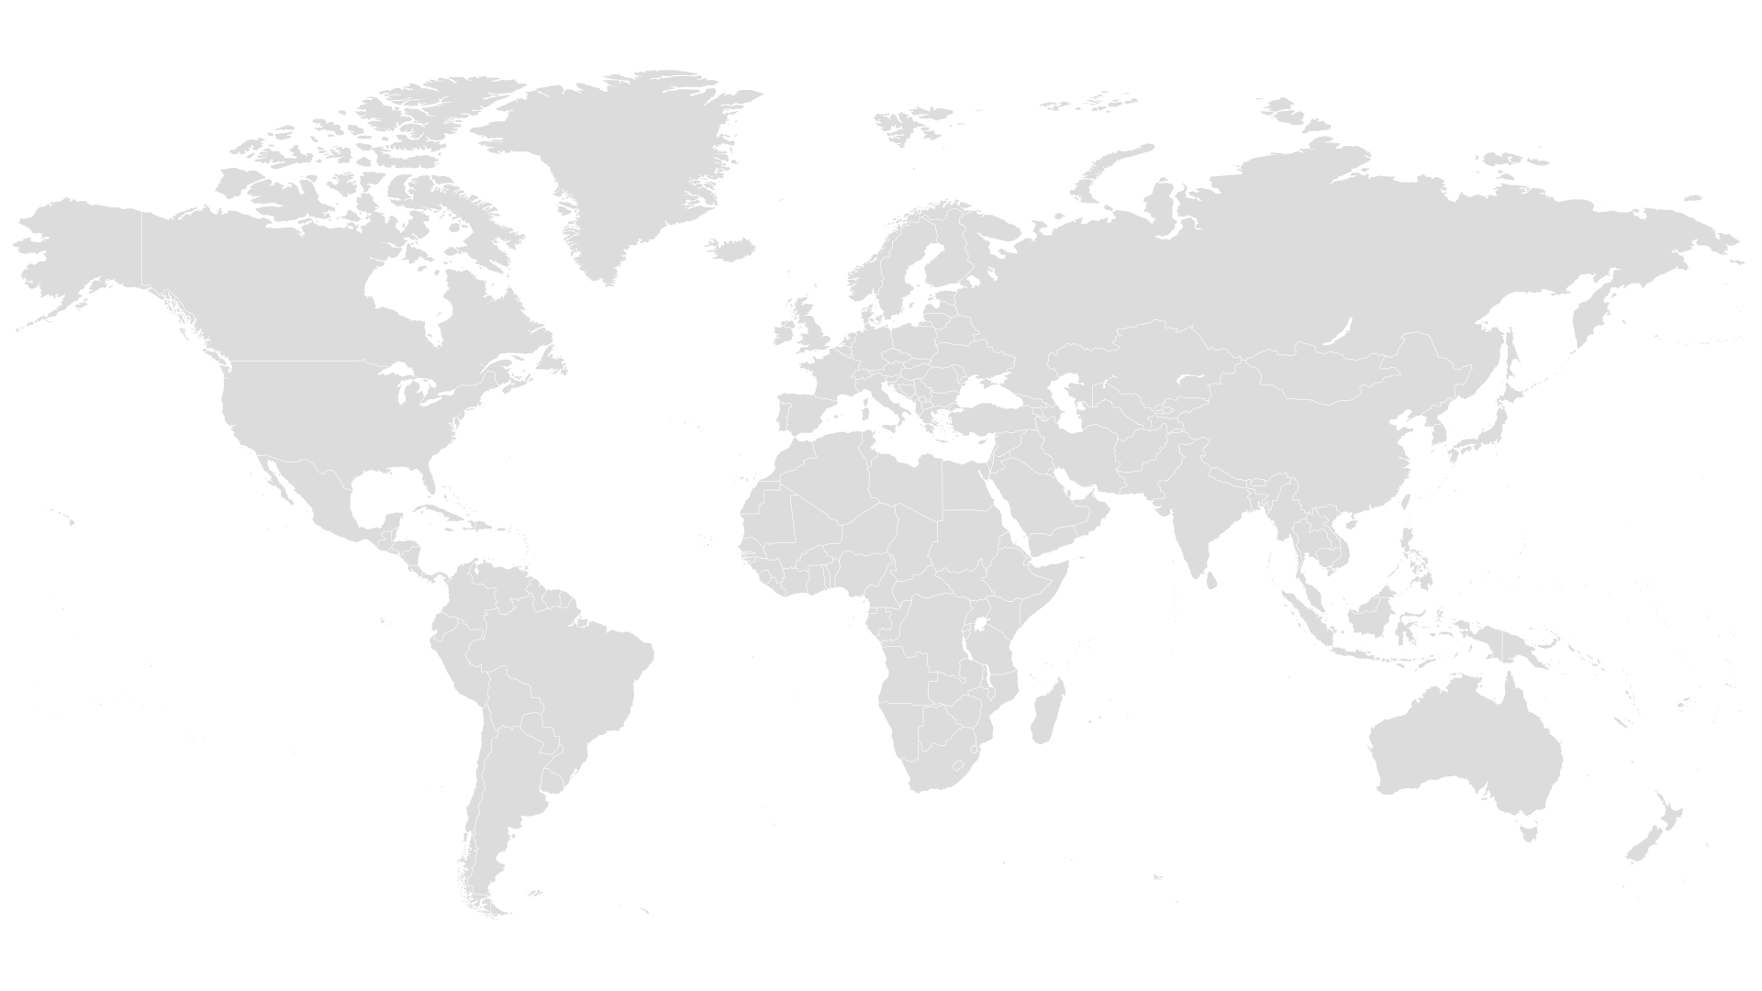
Notes:
SLIDE 18
Developing the accountancy profession that the world needs means going beyond the being a number cruncher. The professional accountants of the future will need a range of skills and at ACCA we express this as the professional quotients for success.
So skills and knowledge need to change too.
Back in 2016, ACCA finished a major piece of research work on the key attributes needed by the profession in this brave new world.
We called these the professional quotients, and they include:
Technical and ethical competencies, or TEQ
Intelligence, or IQ
Emotional intelligence - EQ
Creative intelligence - CQ
Vision – VQ,
Digital – DQ
And experience – XQ
The professional accountant of the future will need an optimal and changing combination of technical knowledge, skills, experience and abilities, combined with interpersonal behaviours and qualities.
It’s not just about knowing the technical areas of accountancy – although these are still critical.
It’s about being a well-rounded strategic professional capable of providing judgement and insight. These are the attributes that will allow ACCA members and other finance professionals around the world to truly engage with the challenges of today and tomorrow.
<CLICK>

Slide 19
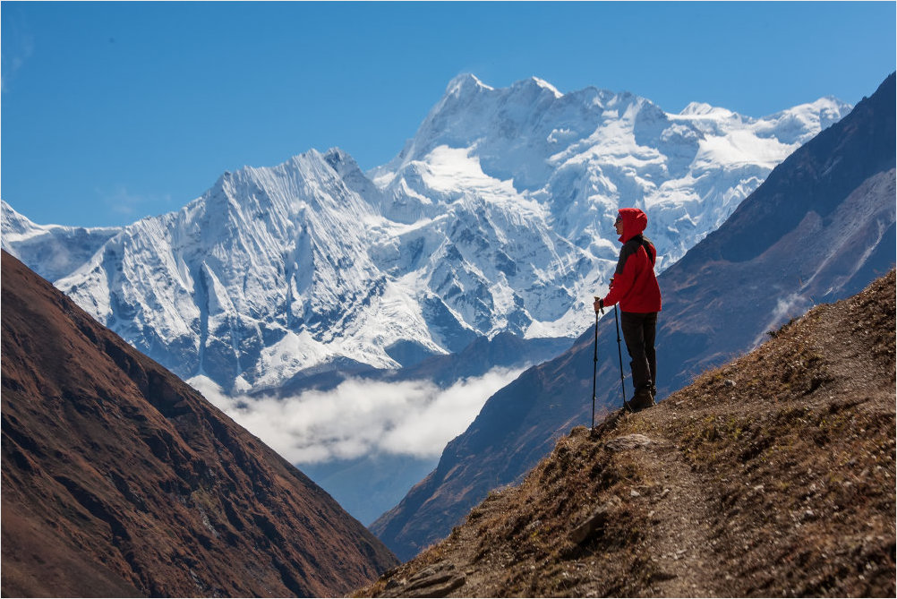
Thank you
Notes:
SLIDE 19
So I hope that gives a sense of some of our perspectives in respect of how the accountancy profession plays a role in protecting the public interest and the seriousness, range of thinking and commitment that we at ACCA are putting into this area.
<<ENDS>>

