Slide 1
Enhancing audit quality & the Role of Public Oversight
Hilde Blomme, Deputy CEO
TURMOB Conference, 1 June 2016

Slide 2





About the Federation of European Accountants (FEE)
50 institutes
875,000 professionals
37 countries
28 EU member states

Slide 3
It is all about Enhancing Audit Quality
Many drivers of audit quality
Regulation and Public Oversight is just one
Not forget f.i. auditor reporting and quality assurance
Refer to profession’s future initiatives, audit committees, Audit Quality Indicators

Slide 4
EU Audit Reform Towards a new organization of public oversight in Europe

Slide 5
Who will be affected by the audit reform?
Directive: audits of all entities
Regulation: audits of Public Interest Entities
PIEs
Listed companies
Credit institutions
Insurance undertakings
Other entities designated by Member States

Slide 6
Directive: Main Provisions
Determines the scope of the Regulation
Definition of PIE
More specific provisions in areas of
Independence and objectivity
Internal organisation of audit firm & audit work
ISA adoption: EC development process
Functioning of audit committees of PIEs
Quality assurance, investigation and sanctions

Slide 7
Quality assurance and oversight (1)
Competent Authority (CA) has ultimate responsibility for the oversight of:
Approval and registration of auditors
Adoption of relevant standards
Continuing education, quality assurance system, investigative and administrative disciplinary systems

Slide 8
Quality assurance and oversight (2)
Quality assurance reviews, investigations and disciplinary matters can no longer be delegated to professional bodies for PIE audits
Quality assurance reviews:
Frequency is risk-based, at least every six years (three years for PIEs)
To be appropriate and proportionate to the scale & complexity of the audited entity

Slide 9
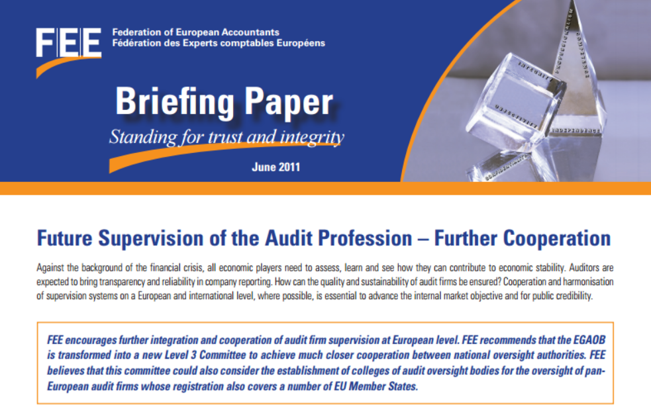
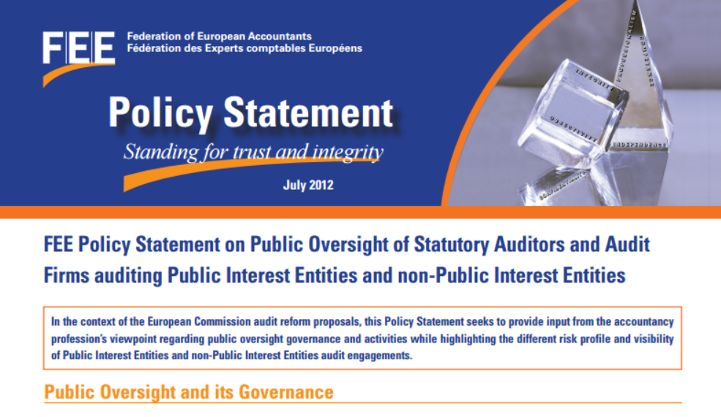
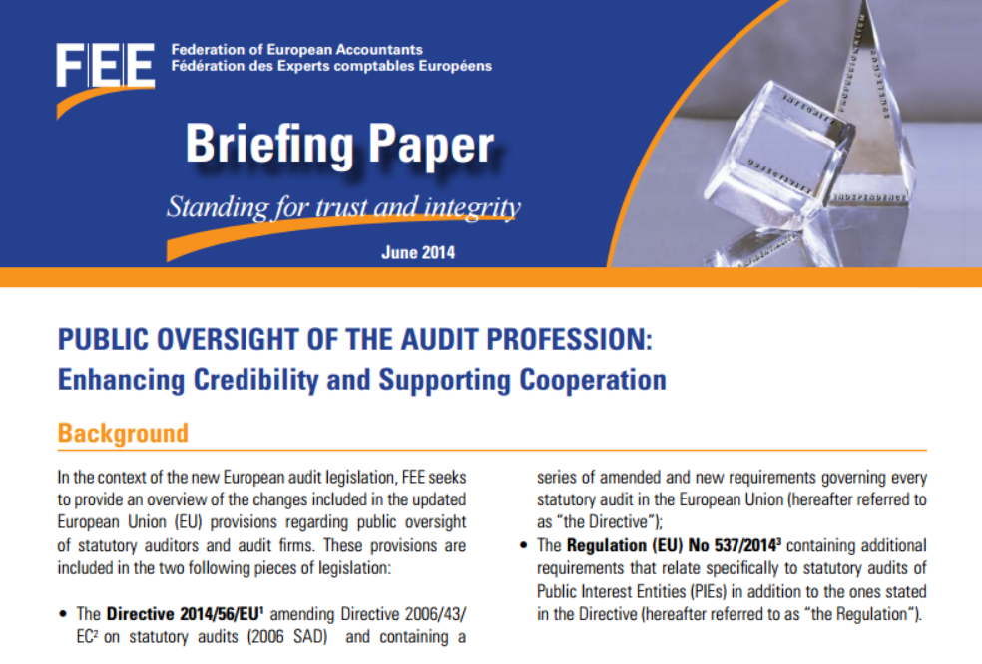
Briefing Papers
Future Supervision of the Audit Profession
Public Oversight of Statutory Auditors and Audit Firms
Public Oversight of the Audit Profession

Slide 10
EU Audit Reform Potential implementation of public oversight…

Slide 11
EU audit reform towards implementation of public oversight…
OVERSIGHT OF | non PIEs | PIEs
Approval and registration of statutory auditors and audit firms | may be delegated | may be delegated
Adoption of relevant standards | may be delegated | may be delegated
Continuing education | may be delegated | may be delegated
Quality assurance system | may be delegated | may NOT be delegated
Investigative and administrative disciplinary system | may be delegated | may be delegated to independent body

Slide 12
Illustration: potential use of delegation of tasks for non-PIE auditors
Caveat: this graph has been prepared for general illustration purposes. It includes information from different sources informally gathered up to May 2016 without any further verification. It may already be out of date when presented and be subject to change. It does not bind the Federation or its Members. The Federation cannot accept or assume any liability or responsibility in this respect.

Slide 13
Illustration: potential use of delegation of tasks for PIE auditors
Caveat: this graph has been prepared for general illustration purposes. It includes information from different sources informally gathered up to May 2016 without any further verification. It may already be out of date when presented and be subject to change. It does not bind the Federation or its Members. The Federation cannot accept or assume any liability or responsibility in this respect.

Slide 14
Looking ahead beyond audit reform: -> The future of Audit & Assurance -> Audit Committees -> Audit Quality Indicators

Slide 15
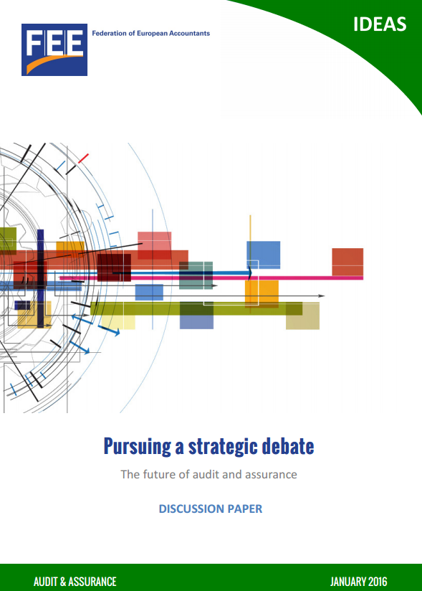
It is All about Audit Quality
A core element in all we do
Shared responsibility for all financial reporting supply chain players
Needs to be properly perceived – and demonstrated
http://www.fee.be/images/publications/auditing/1601_Future_of_audit_and_assurance.pdf

Slide 16




Pursuing a strategic debate to improve quality in reporting, audit & assurance
Projects on the future of Audit and Assurance:
Responding to changing stakeholders’ needs
IT and innovation
Skillset of the future and rethink education

Slide 17
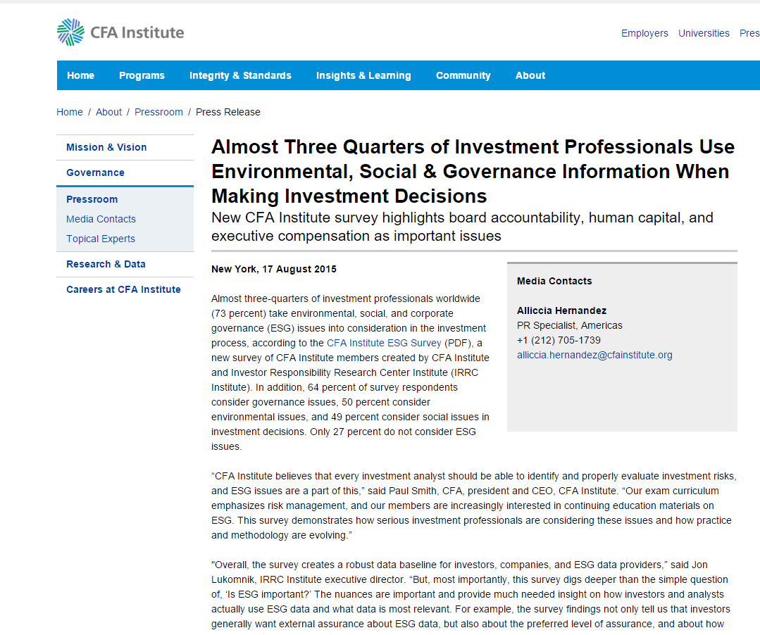
Let’s pause on new investors’ demands
Investors are more & more interested in non-financial information
Value creation
Board accountability
Human capital
Executive compensation

Slide 18
IT & Innovation
How audits are conducted (data analytics, social listening, etc.)
How audit business operates
How business is done

Slide 19
Skillset of the future
Technical expertise (IT, accounting & auditing, mathematics, statistics, etc.) but not only
Values: professional behaviour and ethics
Business: business understanding and related risks, risk management
Need to develop multi-disciplinary teams
Need to promote consistent and international education standards

Slide 20

Audit committee: in the eye of the storm
Significant potential to contribute to audit quality
Building well-functioning audit committees is still work in progress in many European countries
http://www.fee.be/images/publications/company_law/160115_Impact_of_audit_reform_on_audit_committee.pdf

Slide 21
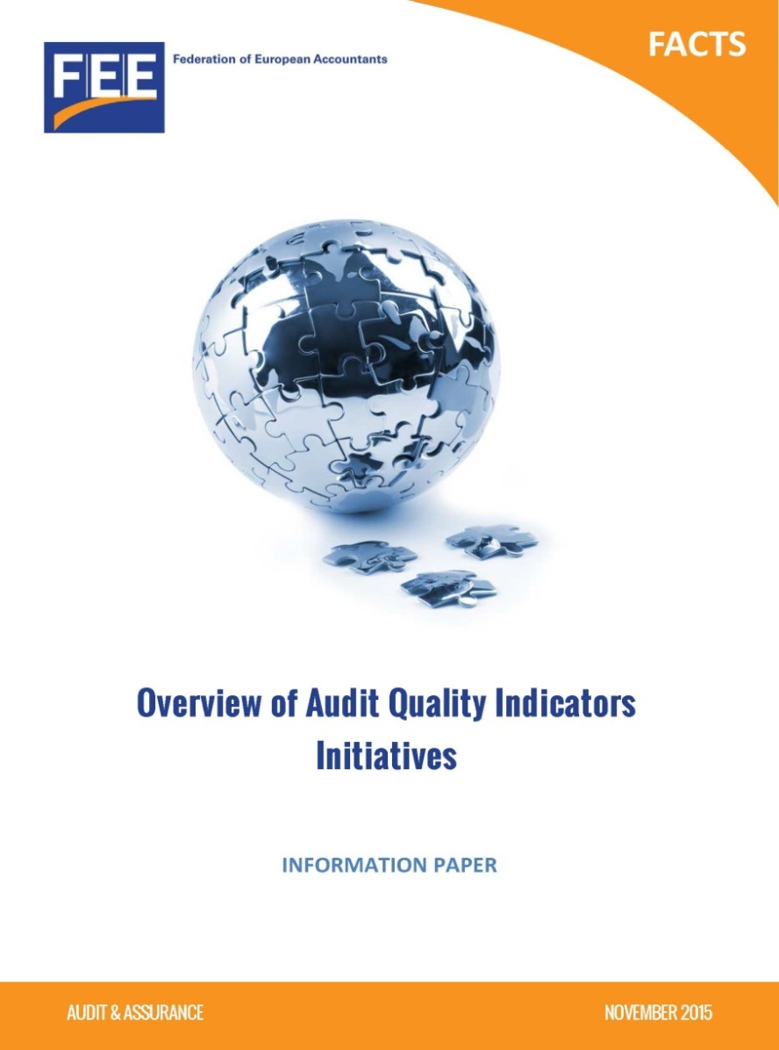
FEE Overview of Audit Quality Indicator Initiatives
Stock-taking of recent initiatives on Audit Quality Indicators (AQIs)
High level summary of similarities and direction of initiatives
http://www.fee.be/images/publications/auditing/1511_Overview_of_Audit_Quality_Indicators_Initiatives.pdf

Slide 22
Highlights
Nine bodies around the world issued either a proposal or an initiative on AQIs
Different issuing bodies: regulators, oversight bodies, professional bodies, audit firms
Different user groups: audit committees, audit firms, investors, and regulators

Slide 23
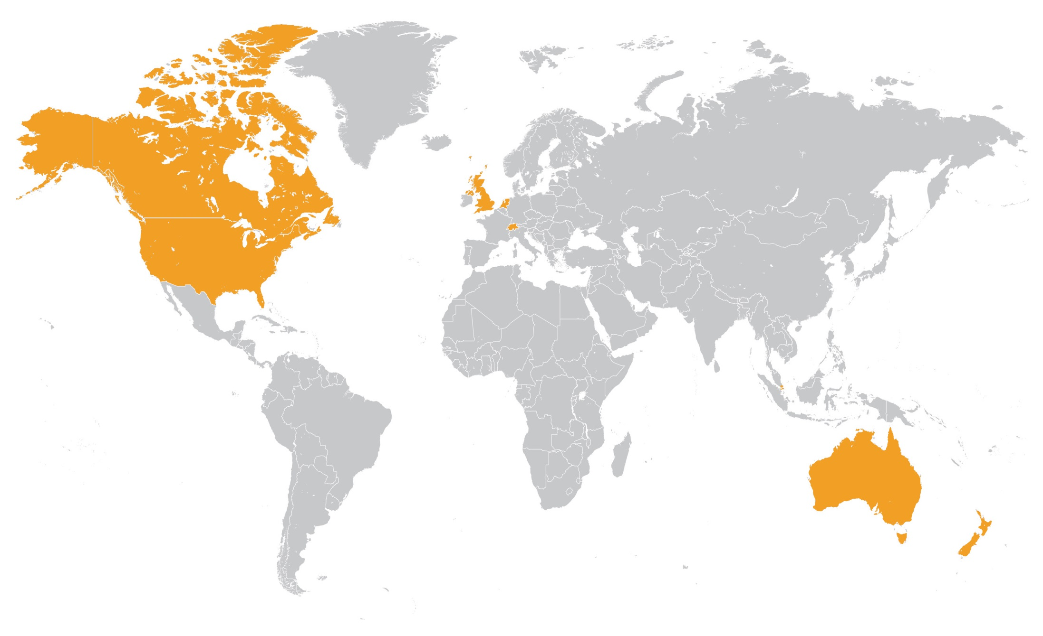
Issuing bodies - AQI Initiatives
CPAB, Canada
FRC & the Big Six, UK
NBA, Netherlands
FAOA, Switzerland
IOSCO*
ACRA, Singapore
PCAOB
The US CAQ
CAANZ, Australia & New Zealand
*IOSCO – an international organisation based in Madrid

Slide 24
Outcome
The most popular AQI: quantum of hours of training undertaken per person
Other frequently mentioned AQIs:
Number of internal engagement quality reviews
Number of external inspections
Number of audit staff per audit partner
Years of experience of audit staff

Slide 25
Finding I
AQIs are predominantly quantitative rather than qualitative

Slide 26
Finding II
Reporting on AQIs public and/or private

Slide 27
Finding III
Different approaches used towards reporting on AQIs

Slide 28
Takeaways from our survey
Quantitative, yes, but with contextual data
No commonly accepted set of AQIs
A clear need to identify ways to measure audit quality
A chance for the profession instead of regulators to enable demonstration of audit quality?

Slide 29




Stay connected
FEE website
Monthly e-newsletter
FEE – Federation of European Accountants
@FEE_Brussels
@FEE_SMP

