Slide 1
The New Auditor’s Report
Jim Sylph
IAASB Auditor Reporting Implementation Working Group Co-Chair
Turkish Accountancy Forum June 1, 2016

Slide 2
Why Change the Auditor’s Report?
Improve relevancy of audit
Enhance communicative value to users
Stimulate more robust interactions and communication between auditor and entity
Improve audit quality and professional skepticism
Enhance preparer focus on key risk areas and disclosures
Clarify responsibilities, and improve understanding of audit

Slide 3
The Journey Thus Far ‒ The Global Landscape
UK – Enhanced reporting by auditor, management and TCWG (year beg Oct 2012)
2013
2014
Netherlands - Enhanced auditor reporting for PIEs, requirements based on ISAs (year-end Dec 2014)
2015
Australia, South Africa, Poland, Germany, Switzerland, Singapore - Some “early birds” with new style audit reports under the ISAs including KAMs
2016
Zimbabwe – mandatory dry runs
May 2016: Re-exposure of auditor reporting proposals
2017
ISAs come into effect for Dec 2016 year ends
EU – Enhanced auditor reporting for all PIEs come into effect

Slide 4
The New Auditor’s Report – What’s Changed
Key Audit Matters
Required for listed entity audits, voluntary for others
Areas of higher risk, significant auditor judgement, matters of significant affect on audit
Communication: why matter is a KAM, how addressed, related F/S disclosures
Documentation: Auditor judgements & decisions on KAM
Matters
communicated with
TCWG
Matters that required
significant auditor attention
Matters of most significance in the audit

Slide 5
KAM – Delivering Entity-Specific Information to Users
Consistency and Comparability
Relevance and Usefulness
Boilerplate; generic language;
not relevant to the entity or the audit
Entity- and audit specific information of increased value

Slide 6
Other Key Features of the New Auditor’s Report
Audit Opinion
Key Audit Matters
Listed entities or voluntary
Present first
Going Concern
Other inform-ation
Auditor, management and TCWG
Independence and ethical obligations
Respons-ibiliites
Engage-ment partner
Identify - listed entities

Slide 7
What we have Heard from Initial Experiences
Some initial evidence of enhanced audit quality, also benefits to corporate governance
a
Positive experience
Now much more engagement between auditor and management
Valued new source of complementary information
Firm procedures need to be determined, early planning and engagement with the entity is critical, write with the audience in mind, becomes easier in successive years
Innovative approaches welcomed--visually appealing reports, information clearly signposted, clear and logical structure
Notes:
.

Slide 8
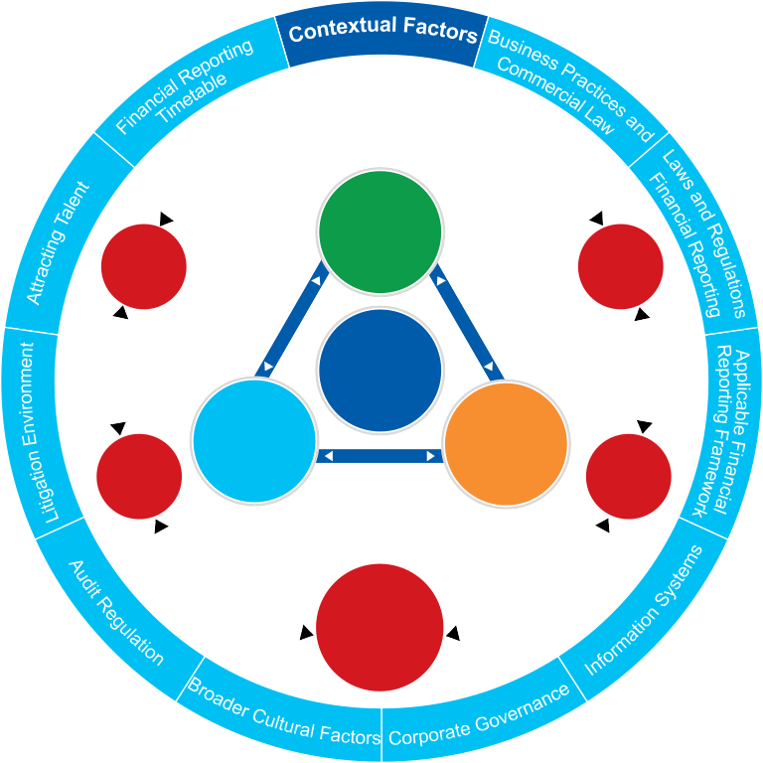
The Relationship between Enhanced Auditor Reporting and Audit Quality
Interactions
Process
TCWG
Regul-
ators
Audit
Quality
Inputs
Outputs
Manage-
ment
Users
Diagram extracted from:
A Framework for Audit Quality: Key Elements that Create an Environment for Audit Quality
February 2014
Auditor

Slide 9
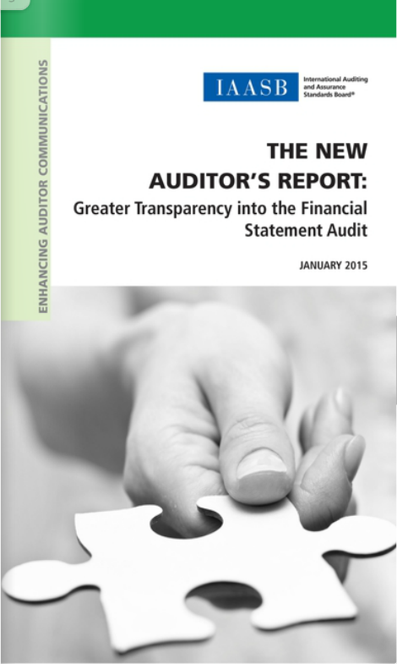
Implementation Resources
Visit www.iaasb.org/auditor-reporting
Auditor Reporting Fact Sheet
Auditor Reporting “At a Glance”
Basis for Conclusions
Guidance on KAM and Going Concern
Illustrative KAM examples
Targeted publications, e.g., “More Informative Auditor’s Reports – What Audit Committees and Finance Executives Need to Know”
….And More

Slide 10
…A Beginning of a Journey

Slide 11
Continuing Improvement to Meet the Public Interest
ISAs fit for purpose
Proactive
quality
manage-
ment
Reinforcing robust communic-
ation
Independent
and challenging
skeptical mindset
Transparency &
audit quality

